Slide 1




Karaganda Economic University of Kazpotrebsoyuz
Kazakhstan
Director of strategic development department,
Karaganda Economic University of Kazpotrebsoyuz
Dr. Sci. (Pedagogy), Professor , Mulikova Saltanat Altayevna

Slide 2




Employment in Kazakhstan
Employment of graduates is not only a problem of graduates, but also the problem of higher education institutions. Every HEI is a subject of two markets: market of educational services and employment market, the operation on both is highly integrated. That is why the employment guaranty is an important competitive advantage on the market of education services, which attracts prospective students.
On the year 2015, according to the statistics of the Ministry of Education of the RK, there are 125 HEI, the amount of bachelor students is 474 841, the coverage of the higher education is 48.4%.
www.keu.kz

Slide 3

Employment in Kazakhstan
Portion of the universities graduates, who are employed according by their specialty during the first year after graduation, is the mark of the national rating of the university. According to Government program of the education development in the Republic of Kazakhstan on the years for the years 2016-2020 this portion should be equal to 75% in 2017, and to 80% in 2020. Moreover, the program states that the level of employer’s satisfaction by the graduates’ professional knowledge and skills should be - 70% in 2017 and - 80% in 2020. According to statistics in the year 2014 - 72% of the graduates were employed in 2014, and 75% in 2015.
Count of the employed graduates of the RK since 2015 is based on the reports from the State center of pension payment (SCPP). In the February of 2015 the first employment data collection and analysis was performed and all data was compared to SCPP. According to that analysis the employment of the Karaganda Economic University graduates on the beginning of 2015 accounted to 80%.
www.keu.kz

Slide 4


Graduates employment problems in Kazakhstan:
Overall shortage of the vacancies;
Lack of the employers interest for young professionals;
Massive layoffs in large enterprises and organizations;
Low competitiveness of graduates in the labor market due to insufficient level of professional skills and experience;
Competition between graduates and experienced workers who were fired during the crisis;
Lack of graduates’ awareness about the demand on the labor market;
Spontaneous labor migration of young population and at the same high demands on candidates salary;
Undeveloped social partnership;
Flexible response mechanisms of the universities educational programs to labor market needs are not regulated, the mechanisms for dual-degree bachelor diplomas are not developed.
www.keu.kz

Slide 5


Government programs
Such government programs as “With diploma to the village", "Youth Practice" and "Youth personnel reserve“ are implemented in the republic in order to support youth.
“Youth Practice” program for HEI’s graduates. In order to gain work experience after graduation, the state offers to graduates a six-month youth practice. To do this, the graduates (under 29 years) should refer to the employment center in the Governor's office of the city (district).
“With diploma to the village” program for students graduated from HEI with majors in: education, health-services, social securities, culture and sport, veterinary science. Program “With diploma to the village” is operating in Kazakhstan since 2009. Government offers vacancies in the villages with appropriate social support.
“Youth personnel reserve” program. With the support of the Ministry of Education and Science of Kazakhstan and People's Democratic Party "Nur Otan" the project "Youth personnel reserve“ was realized, program is aimed on the identification, selection, preparation and training of managerial staff of the country from young, talented and active Kazakhstan youth. Selected specialists should be included in socially significant activities in three areas: civil service, business community, social and political activities.
www.keu.kz

Slide 6


Activities performed by university aimed to solve employment problems:
1. For the purpose of more successful presentation of graduates in the labor market following activities are carried out:
master - classes on such topics as "How to prepare a CV," "How to successfully pass an interview with an employer“, some common mistakes of the candidates for a particular position and the importance of cover letters are discussed;
trainings on the questions of interviewing, interpersonal relationships, methods of adaptation and consolidation in the workplace, improving search technology work in market conditions;
2. The university is systematically organizes work on the organization of master classes, coaching, meetings with employers. On such meetings representatives of the business community, leading experts, managers of large companies met with the students in an informal setting to discuss the construction of a professional career, demonstrate some practical skills, provide information about effective methods and forms of employment.
www.keu.kz

Slide 7
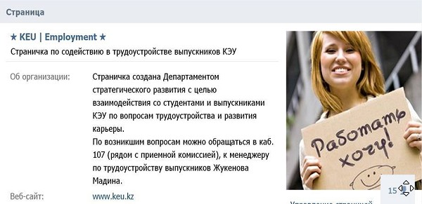
Activities performed by university aimed to solve employment problems:
3.One of the new directions of the work related to employment issues was the creation of the Internet page named "I want to work" in the social network "VKontakte“, that page was created to promote the employment of graduates, that service provides information on job vacancies, invitations to internships, ads about events (workshops, Career Day, links to materials on employment), etc. Another purpose of the page is to maintain constant contact with alumni, track changes in their career, ensure their future cooperation.
University analyzes the Kazakh labor data bases in the Internet (Rabota.nur.kz, rabota.yandex.kz, OLX, hh.kz, quzmet.kz) subject to specialties offered by university. Then, based on analysis of the above-mentioned websites links to available vacancies are published in the community "I want to work" on the page in social network "VKontakte“.
www.keu.kz

Slide 8


Activities performed by university aimed to solve employment problems:
4. Every year in the November the "Career Day”, where employers of Karaganda region are invited, is held and organized by the university for graduates. The main purpose of "Career Day" – is to assist in the temporary and permanent employment of students and graduates of the university, as well as the promotion of employers in the selection of promising young professionals. All employers are receiving CD disc which contain electronic resume KEUK graduates.
On the 16 of November of 2015 on the “Career Day” 96 organizations were invited. An interview with students and business representatives regarding employment issues was held in the framework of “Career Day”.
.
www.keu.kz

Slide 9

Activities performed by university aimed to solve employment problems:
5. Much attention is paid to the practice-based learning in the university. Particularly:
Annually "Platinum lectures“ are held. That lectures read by heads of government agencies and large organizations in the region and leading experts to familiarize students and professors with the achievements, problems and prospects of a particular industry, to encourage students to achieve professional career growth and development on the example of personal and professional qualities and competence of lecturers;
Practical work experience - the most important stage of learning, which allows students to move from theoretical knowledge to practice. Illustrative examples help to better assimilation of the theory by students, have positive effect on student performance and attitudes about their future profession.
Thesis themes are commissioned by the enterprises interest, employers are invited to attend the National Certification Commission and conduct training sessions for joint discussions and coordination of the curriculum, their opinion is taken into account in compiling the catalog of elective subjects, reviewing job training programs.
www.keu.kz

Slide 10

Activities performed by university aimed to solve employment problems:
6. The university works closely with the graduates, who are employers now and who have an opportunity to employ graduates.
7. A good tradition is the conclusion of tripartite agreements between the university, student and an employer under which the employer guarantee employment of graduate after graduation.
Following employers are practice such agreements: JSC “Kazakhmys Corporation”, JSC “ArselorMittal”, JSC “Shubarkul Komir”, LLP “Tabys Audit Consulting”, LLP “April-Kulager”, Meat processing plant in Shakhtinsk, etc.
www.keu.kz

Slide 11


Activities performed by university aimed to solve employment problems:
8. Today the problem of education quality occupies a central position in the modern national education policy and science. The procedures and criteria used for the evaluation of the training quality of the university are multifaceted and cover all the contents of the educational process. One of the criteria, which is becoming increasingly relevant in evaluating the quality of graduates training – is an assessment of the employers opinion.
Marketing research on "Satisfaction of employers by KEUK’s graduates and identification of competencies required by the labor market" which is systematically carried out at the university, allowed to determine the further direction of work on the graduates employment.
www.keu.kz

Slide 12
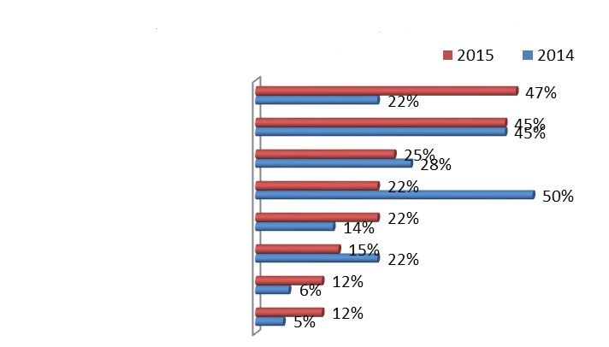
“What methods do your organization use for the professional employee selection?”
Employers were asked to select most appropriate answer on the question: “What methods do your organization use for the professional employee selection?” Several options were offered and it was permitted to select 1, 2, or 3 options.
Majority of respondents chose following options: on the base of competition (47%), direct selection (45%). Some answered: information from the colleagues (25%), vacancies fairs (22%), advertisings in the newspapers (22%), organization’s own web-site (15%) and employment agencies (12%). 12% of the respondents have chosen “other” option, where they have stated: by recommendations, CVs collection, employment web-sites.
On the base of competition
Direct selection
Information from the colleagues
Vacancies fair
Own web-site
Employment agency
Other: CV collection, web-sites
www.keu.kz

Slide 13
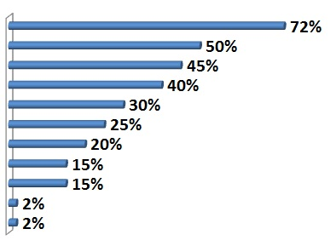
“What skills should have a university graduate to get a job in your organization?”
During the employment of the young employee employer always imposes a number of requirements from which he determines the professional level of a given candidate, in order to determine the extent of his ability to work.
Results of the answers on question “What skills should have a university graduate to get a job in your organization?” (it was offered to choose max. 3 options from the offered list). Analysis showed that greatest influence on the efficiency of the university graduates work was exerted by:
Knowledge in the professional sphere
Competitiveness and permanent self-improvement
Practical skills
Computer literacy
Knowledge of industry particularities
Ability to anticipate problem
Foreign languages
Modern technologies
Knowledge in narrow specialty
Easy-learners, sociable
www.keu.kz

Slide 14
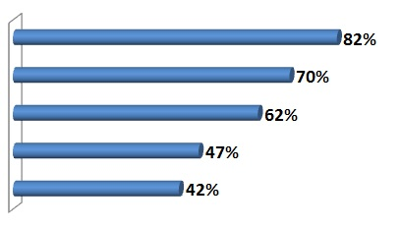
“What kind of personal qualities a specialist should have?”
On the question “What kind of personal qualities a specialist should have?” (it is was offered to choose max. 3 options) majority of employers answered following:
Responsibility
Professional curiosity
Hard working
Creative thinking
Communicable
Moreover such qualities as stress resistance, commitment, self-confidence, the ability to conduct business negotiations are also must be added to the list of frequently asked.
www.keu.kz

Slide 15


“What kind of personal qualities a specialist should have?”
Herewith, it should be noted, that some comments from the employers side were made as well:
Poor attendance of employment events by students (poor awareness, low activity, etc.);
Lack of the employment center in a university or among those responsible for the organization of work with companies interested in attracting students and graduates;
Low interest of regional and city centers in collaboration with employers;
High prices for the employment center services;
Insufficient level of events organization and other forms of the work with young specialists;
Lack of new exciting formats of the event at the university.
www.keu.kz

Slide 16
Thank you for attention!
We hope that participation in the project 561603-EPP-1-2015-1-DE-EPPKA2-CBHE-JP «The creation of competence and employment centers» (Complete) will bring contemporary content, innovative technologies, forms and methods to our university in the course of employment of graduates.
www.keu.kz

